Slide 1


APACHE SPARK DEEP DIVE -----JOIN WITHOUT SHUFFLE----

Slide 2

Join without Shuffle
Question : There are two data frames , let’s say
SmallDF and the
LargeDF,
Need to join them on id column with causing the shuffle in the Apache spark as the compute engine ?
Also, broadcast join is disabled ??

Slide 3

Solution
At the conceptual level, the solution can be achieved if we can,
Co-locate the RDDs with the joining keys in the same partition
And
This can only happen if Two RDDs have
The same partitioner
Were shuffled as part of the same Action.
Let see how to achieve it in more detail:

Slide 4
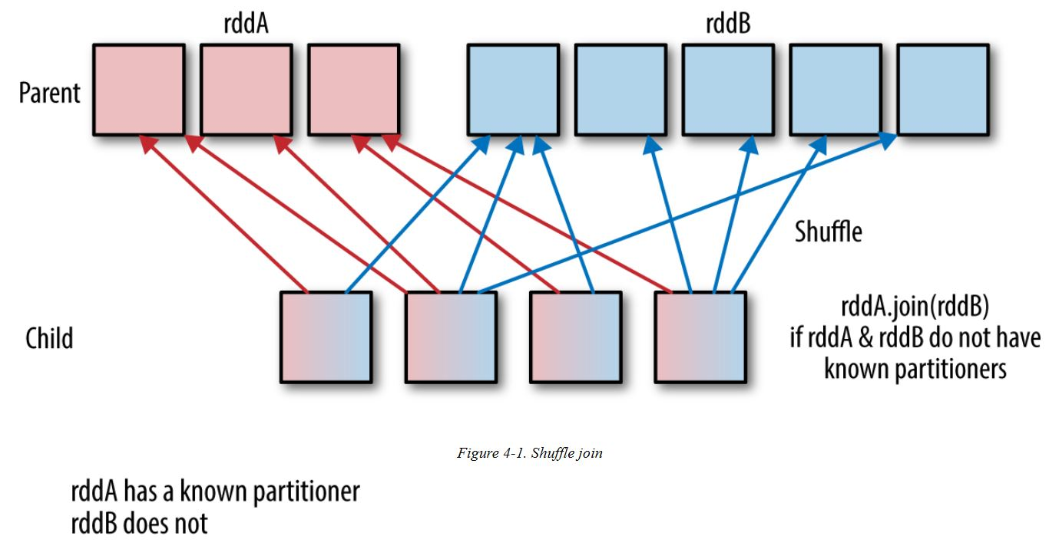
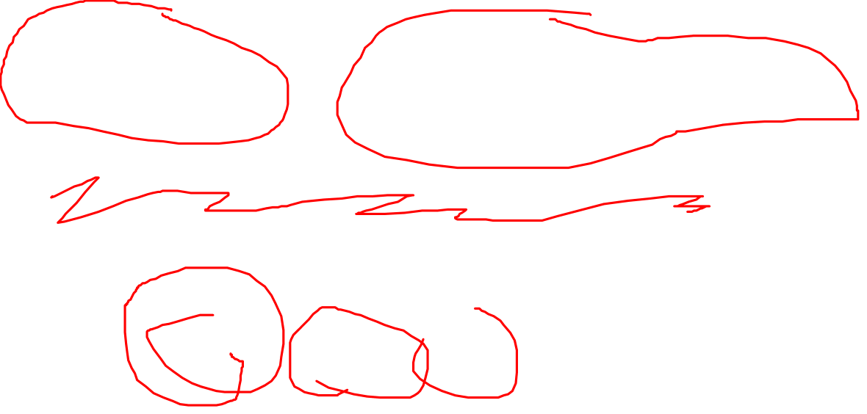
The cost of the join increases with the number of keys and the distance the records have to travel in order to get the correct partition.

Slide 5
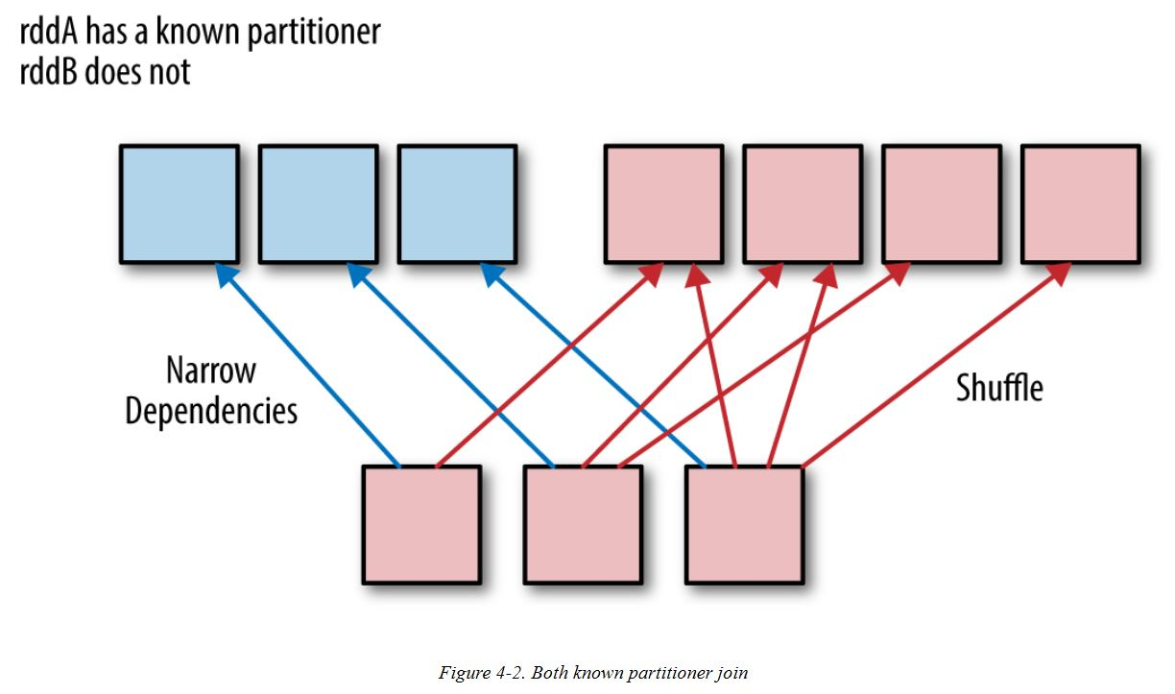

rddaA has Known Partitioner

Slide 6
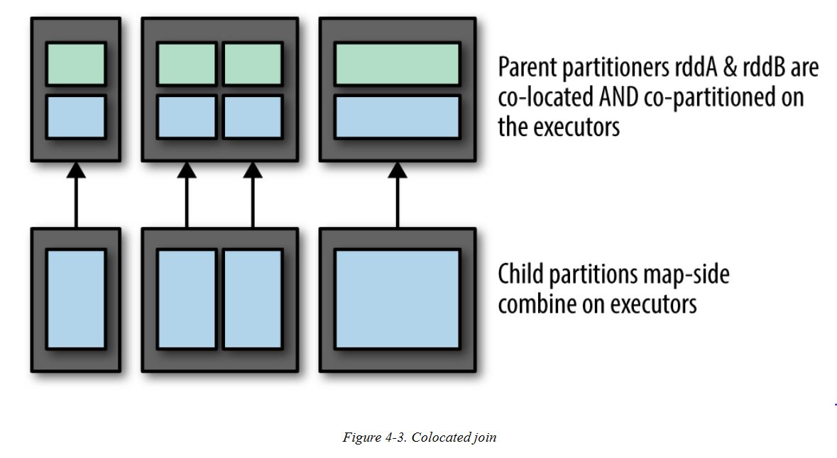
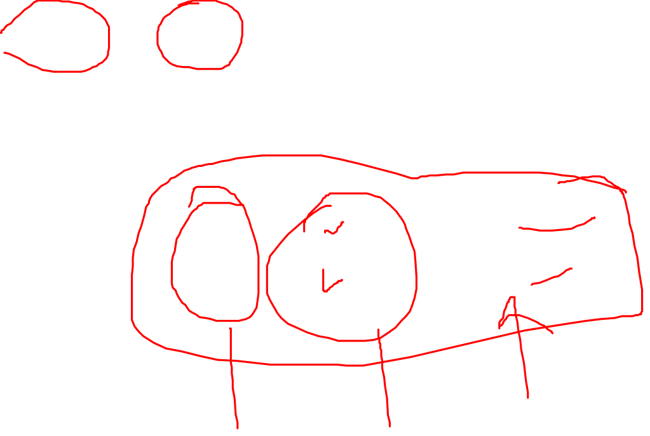
rddaA and rddB – Co-located and co-partitioned

Slide 7
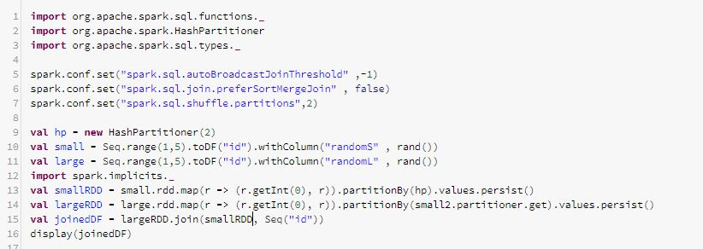
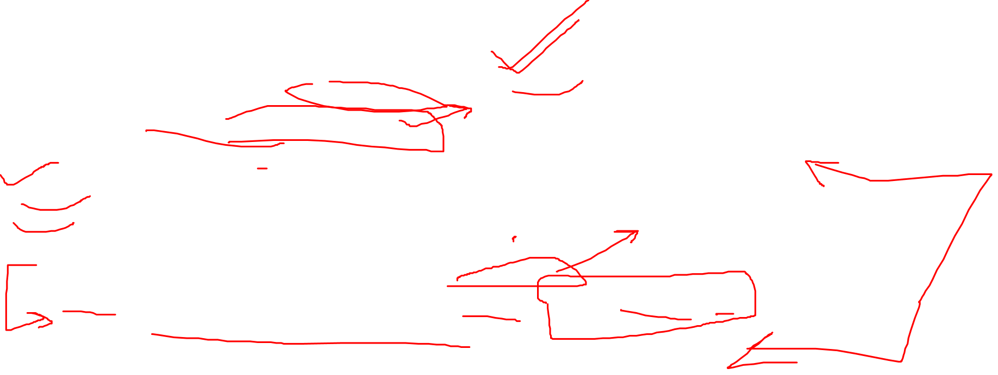
smallRDD and largeRDD – Co-located and co-partitioned

Slide 8
Conclusion
If the RDDs sharing the same partitioner are materialized by the same action, they will end up being co-located.
which can even reduce Shuffles and thus network traffic
(Almost) always persist after repartitioning.

Slide 9
Thanks and do subscribe to my channel

